Slide 1
Software Quality Assurance Process
Chapter 6:
(4 Hrs)
Presented by
Er.Harendra Bikram Shah
Lecturer
Department of Computer Engineering
NAST

Slide 2
OUTLINES
6.1 Software Quality Concepts, Software Reliability
6.2 Software Quality Management and Planning
6.3 Software Standards and their Compliance
6.3.1 ISO, CMMI
6.4 Capability Assessment and Process Improvement
6.5 Process and Product Standards
6.6 Reviews and Inspections

Slide 3
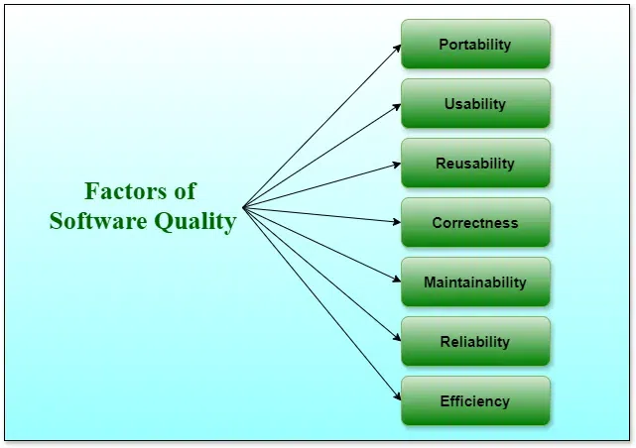
Software Quality Concepts
Software quality refers to the degree to which a software product meets specified requirements and user expectations.
Software Quality shows how good and reliable a product is

Slide 4
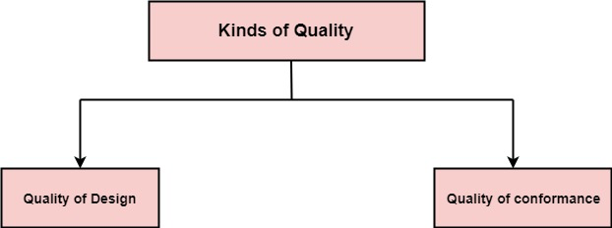
Software Quality Assurance (SQA)
Quality defines to any measurable characteristics such as correctness, maintainability, portability, testability, usability, reliability, efficiency, integrity, reusability, and interoperability.
Quality of Design: refers to the characteristics that designers specify for an item.
Quality of conformance: is the degree to which the design specifications are followed during manufacturing.

Slide 5
Software Quality Assurance (SQA)
Software quality assurance is a systematic plan of all actions necessary to provide adequate confidence that an item or product conforms to establish technical requirements.
Software Quality Assurance (SQA) is simply a way to assure quality in the software.
It is the set of activities which ensure processes, procedures as well as standards are suitable for the project and implemented correctly.
Software Quality Assurance (SQA) focuses on
software’s portability
software’s usability
software’s reusability
software’s correctness
software’s maintainability
software’s error control
Software Quality Assurance (SQA) has
A quality management approach.
Formal technical reviews.
Multi testing strategy.
Effective software engineering technology.
Measurement and reporting mechanism.

Slide 6
Major (SQA) Activities
SQA Management Plan:
Set The Check Points:
Measure Change Impact:
Multi testing Strategy:
Manage Good Relations:
Maintaining records and reports :
Reviews software engineering activities :
Formalize deviation handling :

Slide 7
Benefits of Software Quality Assurance (SQA)
SQA produces high quality software.
High quality application saves time and cost.
SQA is beneficial for better reliability.
Improving the process of creating software.
Improves the quality of the software.
Disadvantage of Software Quality Assurance (SQA)
Cost:
Time Consuming:
Overhead:

Slide 8
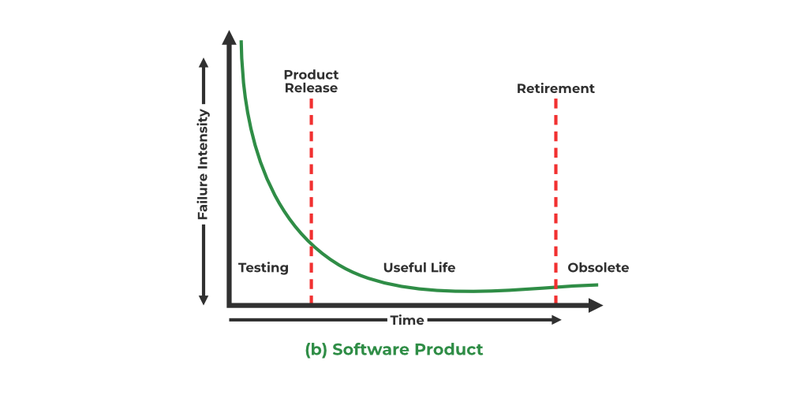
Introduction to Software Reliability
probability that the software will operate failure-free for a specific period of time in a specific environment.
It is measured per some unit of time.

Slide 9
Introduction to Software Reliability
Factors Affecting Reliability:
Design Quality:
Testing:
Operational Environment:
Maintenance:
Complexity:
Techniques for Improving Reliability:
Fault Tolerance:
Redundancy:
Error Handling:
Monitoring and Logging:
Documentation and Training

Slide 10
Measures of Reliability and Availability
Feature | Reliability | Availability
Definition | It is the ability of a system to deliver services correctly under given conditions for a given period of time. | It is the probability that a system, at a given point in time, would remain operational under normal circumstances.
Measurement | Reliability can be measured using metrics such as Mean Time Between Failures (MTBF) or Mean Time to Repair(MTTR). | Availability is usually measured as a percentage and is calculated as the ratio of the system’s uptime to the total time (uptime + downtime) within a given time frame.
Focus | It refers to a failure-free operation during an interval. | It refers to failure-free operation under normal circumstances at a specific instant of time.
Time Frame | It is a long-term measure that looks at the overall performance of a system over its operational lifespan | It is a short-term measure that assesses the system’s current state and its ability to be available and operational at any given moment.
Factors | Maintenance, design quality, and component lifespan. | Downtime, maintenance schedules, and fault tolerance strategies.

Slide 11
Measures of Reliability and Availability
Two commonly used measures of reliability in software engineering are:
Mean Time Between Failures (MTBF):
MTBF represents the average time elapsed between two consecutive failures in a system.
It's calculated by
MTBF:=(total operational time) / (number of failures)
Mean Time To Failure (MTTF):
MTTF represents the average time until the first failure occurs in a system.
It's calculated by
MTTF:= (total operational time) /(number of failures)
Availability= Uptime(MTBF)/Total Time(MTBF+MTTR)

Slide 12
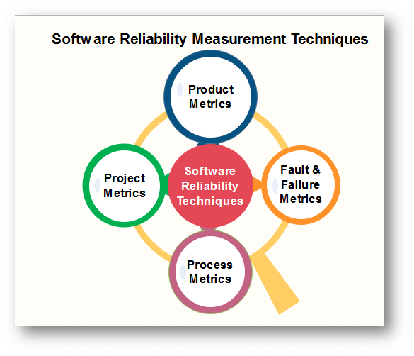
Software Reliability Measurement Techniques

Slide 13
Software Reliability Measurement Techniques
Product Metrics :
metrics help in the assessment if the product is right sufficient through records on attributes like usability, reliability, maintainability & portability.
Project Management Metrics:
Project metrics define project characteristics and execution.
These metrics are:
Number of software developers
Staffing pattern over the life-cycle of the software
Cost and schedule
Productivity
Process Metrics
Process metrics quantify useful attributes of the software development process & its environment
Examples are:
The effort required in the process
Time to produce the product.
Fault and Failure Metrics
A fault is a defect in a program which appears when the programmer makes an error and causes failure when executed under particular conditions.
These metrics are used to determine the failure-free execution software.

Slide 14
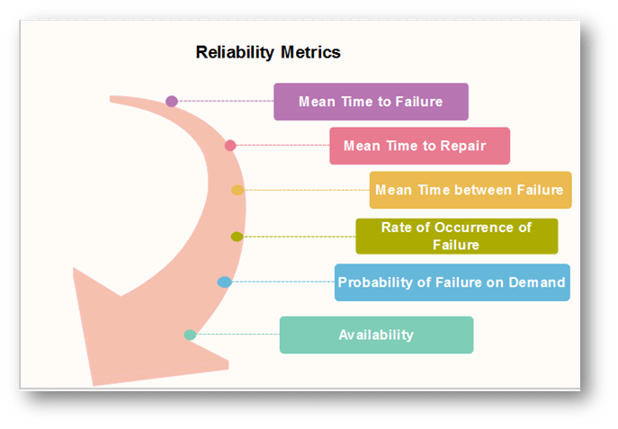
Reliability Metrices

Slide 15

Reliability Metrices
Mean Time to Failure (MTTF)
MTTF is described as the time interval between the two successive failures.
An MTTF of 200 mean that one failure can be expected each 200-time units
To measure MTTF, we can evidence the failure data for n failures.
Let the failures appear at the time instants t1,t2.....tn.
MTTF can be calculated as
Mean Time to Repair (MTTR)
Once failure occurs, some time is required to fix the error.
MTTR measures the average time it takes to track the errors causing the failure and to fix them.
Mean Time Between Failure (MTBR)
We can merge MTTF & MTTR metrics to get the MTBF metric.
MTBF = MTTF + MTTR

Slide 16
Rate of occurrence of failure (ROCOF)
It is the number of failures appearing in a unit time interval.
A ROCOF of 0.02 mean that two failures are likely to occur in each 100 operational time unit steps.
It is also called the failure intensity metric.
Probability of Failure on Demand (POFOD)
POFOD is described as the probability that the system will fail when a service is requested.
It is the number of system deficiency given several systems inputs.
POFOD is the possibility that the system will fail when a service request is made.
A POFOD of 0.1 means that one out of ten service requests may fail.
Availability (AVAIL)
Availability is the probability that the system is applicable for use at a given time.
It takes into account the repair time & the restart time for the system.
If a system is down an average of four hours out of 100 hours of operation, its AVAIL is 96%.

Slide 17
Software Quality Management
It ensures that the required level of quality is achieved by submitting improvements to the product development process.
Activities of Software Quality Management:
Quality Assurance -
Quality Planning -
Quality Control -
Benefits of SQM:
Increased Reliability:
Improved Customer Satisfaction:
Reduced Costs:
Enhanced Productivity:
Compliance:

Slide 18
Software Quality Planning
It is a foundational step in (SQM) that establishes the framework for achieving quality objectives in a software project.
Objectives of Software Quality Planning:
Define Quality Goals:
Align with Stakeholder Needs:
Select Quality Standards and Processes:
Mitigate Risks:
Resource Allocation:
Elements of Software Quality Planning:
Requirement Analysis:
Quality Standards and Metrics:
Quality Management Plan:
Risk Assessment:
Testing Strategy:
Process Definition:
Training and Resource Planning:

Slide 19
Software Quality Planning
Steps in Software Quality Planning:
Understand the Project Scope:
Develop the Quality Management Plan:
Define Roles and Responsibilities:
Set up Monitoring Mechanisms:
Iterate and Refine:
Tools for Software Quality Planning:
Project Management Tools: JIRA, Trello, Asana
Requirements Management: IBM DOORS, Jama Connect
Testing Frameworks: Selenium, JUnit, TestNG
Metrics and Reporting: SonarQube, Google Data Studio
Benefits
1. Improved Quality of Deliverables
2. Alignment with Customer Expectations
3. Early Risk Identification and Mitigation
4. Cost Efficiency
5. Enhanced Collaboration and Accountability
6. Process Standardization
7. Timely Delivery
8. Better Decision-Making

Slide 20
Software Quality Standards: ISO and SEI
ISO/IEC 25000 (SQuaRE): The International Organization for Standardization (ISO) and the International Electrotechnical Commission (IEC) developed the ISO/IEC 25000 series, also known as the Software Product Quality Requirements and Evaluation (SQuaRE) standards.
ISO/IEC 9126: This standard, which has been superseded by ISO/IEC 25010, focused on software quality characteristics and metrics.
ISO/IEC 12207: The ISO/IEC 12207 standard outlines the Software Life Cycle Processes, providing guidelines for the development, maintenance, and management of software products.
CMMI (Capability Maturity Model Integration): Developed by the Software Engineering Institute (SEI) at Carnegie Mellon University, CMMI is a process improvement framework that helps organizations optimize their software development processes.
IEEE 730: This standard, titled "IEEE Standard for Software Quality Assurance Plans," provides guidelines for developing and documenting software quality assurance plans.
IEEE 1061: The "IEEE Standard for Software Quality Metrics Methodology" establishes a framework for defining and applying software quality metrics.
ISO/IEC 9000 series: While not specifically focused on software, the ISO 9000 series provides general quality management principles and guidelines that can be applied to software development processes.

Slide 21
Software quality standards
ISO Standards in Software Engineering
Different types of ISO standards :
ISO 9000: 2000: contains Quality management systems, fundamentals, and vocabulary.
ISO 9000-1: includes Quality management systems and Quality assurance standards.
ISO 9000-2:includes Quality management systems and Quality assurance standards.
ISO 9000-3:contains Quality management systems, Quality assurance standards and also includes guidelines
ISO 9001: has Quality systems and a Quality assurance model.
ISO 9001: includes Quality management systems.
ISO 9002: includes some Quality systems.
ISO 9003: Includes some Quality systems.
ISO 9004: Include some Quality management systems.
ISO 9039: include some Optics and Optical Instruments.
ISO/IEC 9126-1:Includes some software products, quality models.
ISO/IEC 9040:Includes open system interconnection and Virtual terminal basic class service.
ISO/IEC 9041-1: Includes open system interconnection, Virtual terminal basic class service protocol
ISO/IEC 9041-2: Include information technology, open system interconnection, Virtual terminal basic class
ISO/IEC 9075-9: Has information technology, Database languages, and SQL/MED
ISO/IEC 9075-10: Has information technology, Database languages, and SQL/OLB (Object Language Bindings).
ISO/IEC 9075-13: has information technology, Database languages, SQL routines, and Java Programming

Slide 22
SEI [Software Engineering Institute] Software quality standards
1.Capability Maturity Model Integration (CMMI):
CMMI is one of the most well-known and widely adopted SEI standards.
It provides a framework for organizations to assess and improve their software development processes.
2. Capability Maturity Model (CMM):
predecessors to CMMI used for assessing and improving software development processes
3.Team Software Process (TSP):
framework for building high-performance teams and managing the development of software-intensive systems.
TSP emphasizes disciplined team-based practices and focuses on improving both individual and team performance throughout the software development lifecycle.
4. Personal Software Process (PSP):
(PSP) is a set of software engineering practices designed to help individual developers improve their personal productivity and software quality.
PSP provides developers with a structured approach to planning, tracking, and managing their work, with an emphasis on defect prevention and measurement.
5. Software Product Line Engineering (SPLE):
(SPLE) is an approach to software development that emphasizes systematic reuse of software assets across multiple products within a product line.

Slide 23
ISO Software Testing Standards
1. ISO/IEC/IEEE 29119 - Software Testing:
comprises a series of documents that define an internationally recognized approach to software testing.
2. ISO 9000-3 - Software Quality Assurance:
Although not specific to software testing, ISO 9000-3 provides guidelines for applying ISO 9001 quality management principles to software development and maintenance processes.
3.ISO/IEC 25000 series - Software Quality Requirements and Evaluation (SQuaRE):
defines a framework for software product quality requirements and evaluation.
4.ISO/IEC 25010 - Systems and Software Engineering - Systems and Software Quality Models:
ISO/IEC 25010 defines a quality model for software products, specifying eight quality characteristics: functionality, reliability, usability, efficiency, maintainability, portability, compatibility, and security.
5. ISO/IEC 20246 - Test Documentation:
ISO/IEC 20246 provides guidelines for creating test documentation, including test plans, test cases, and test reports.

Slide 24
CMMI SOFTWARE Standards
It is a process improvement model that helps organizations achieve their business goals by improving their software engineering capabilities.
CMMI was developed by the Software Engineering Institute (SEI) at Carnegie Mellon University, and it is based on the best practices of successful software organizations.
Objectives of CMMI
Fulfilling customer needs and expectations.
Value creation for investors/stockholders.
Market growth is increased.
Improved quality of products and services.
Enhanced reputation in Industry.
CMMI Representation
Staged Representation :
  uses a pre-defined set of process areas to define improvement path.
  maturity level describes the maturity of processes in organization.
Continuous Representation :
  allows selection of specific process areas.

Slide 25
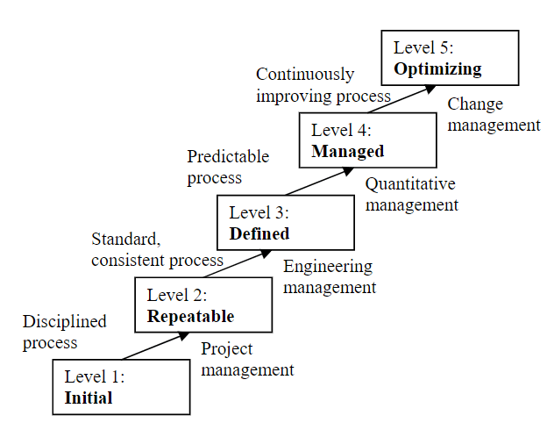
CMMI Model – Maturity Levels

Slide 26
CMMI Model – Capability Levels
A capability level includes relevant specific and generic practices for a specific process area that can improve the organization’s processes associated with that process area.
Capability level 0 : Incomplete
  incomplete process – partially or not performed.
  this capability level is same as maturity level 1.
Capability level 1 : Performed
process performance may not be stable.
only a start-step for process improvement.
Capability level 2 : Managed
  process is planned, monitored and controlled.
  actively managing processing with the help of metrics.
Capability level 3 : Defined
  a defined process is managed and meets the organization’s set of guidelines and standards.
  Focus is process standardization.

Slide 27
CMMI Model – Capability Levels
Capability level 4 : Quantitatively Managed
  process is controlled using statistical and quantitative techniques.
  quantitative objectives for process quality and performance are established.
Capability level 5 : Optimizing
  focuses on continually improving process performance.
  performance is improved in both ways – incremental and innovation.

Slide 28
Process and Product Standards
1. Process Standards
Process standards define the procedures and methods to be followed during software development.
These standards aim to standardize how software is created, tested, and maintained.
Examples of Process Standards
ISO/IEC 12207:
ISO/IEC 15504 (SPICE):
Capability Maturity Model Integration (CMMI):
Components of Process Standards
Development Process: Specifies stages such as requirements gathering, design, coding, testing, and deployment.
Documentation: Standards for creating and maintaining technical documents.
Testing Procedures: Guidelines for unit, integration, and system testing.
Project Management: Standards for scheduling, resource allocation, and risk management.
Benefits of Process Standards
Improved project predictability and efficiency.
Enhanced communication and collaboration within teams.
Consistency in software quality across projects.

Slide 29
Product Standards
Product standards focus on the features and characteristics of the final software product.
They define quality criteria, documentation, and deliverables that the product must meet.
Examples of Product Standards
ISO/IEC 25010:
IEEE 830:
IEEE 1016:
Components of Product Standards
Code Quality: Standards for coding style, readability, and maintainability.
Performance: Metrics for speed, scalability, and efficiency.
Reliability and Security: Guidelines to minimize defects and vulnerabilities.
User Documentation: Requirements for user manuals and help systems.
Benefits of Product Standards
Higher reliability and maintainability of software.
Compliance with industry or regulatory requirements.
Clear benchmarks for product acceptance and quality assurance.

Slide 30
Software Reviews and Inspections
Software Review is a systematic inspection of software by one or more individuals who work together to find and resolve errors and defects in the software during the early stages of the Software Development Life Cycle (SDLC).
Objectives of Software Review
To improve the productivity of the development team.
To make the testing process time and cost-effective.
To make the final software with fewer defects.
To eliminate the inadequacies.

Slide 31
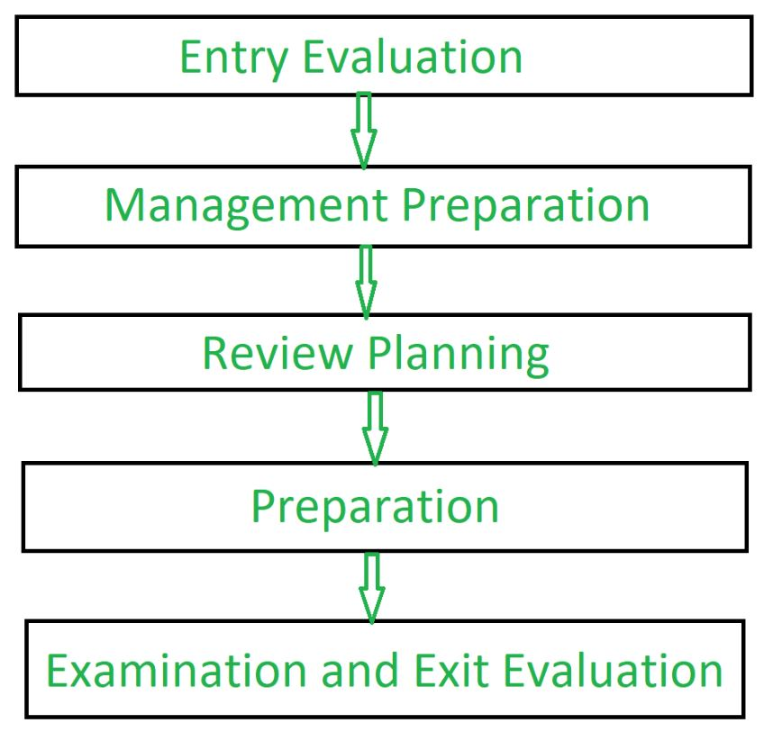
Process of Software Reviews

Slide 32
Software Reviews
Types of Software Reviews
1. Software Peer Review
Peer review is the process of assessing the technical content and quality of the product and it is usually conducted by the author of the work product along with some other developers.
Peer Review has following types:
Code Review: Computer source code is examined in a systematic way.
Pair Programming: It is a code review where two developers develop code together at the same platform.
Walkthrough:
Technical Review:
Inspection: In inspection the reviewers follow a well-defined process to find defects.

Slide 33
Software Reviews
Types of Software Reviews
2. Software Management Review
Software Management Review evaluates the work status.
In this section decisions regarding downstream activities are taken.
3. Software Audit Review
Software Audit Review is a type of external review in which one or more critics, who are not a part of the development team, organize an independent inspection of the software product and its processes to assess their compliance with stated specifications and standards.
This is done by managerial level people.

Slide 34
Software Reviews
Advantages of Software Review
Defects can be identified earlier stage of development (especially in formal review).
Earlier inspection also reduces the maintenance cost of software.
It can be used to train technical authors.
It can be used to remove process inadequacies that encourage defects.

Slide 35
Software Inspections
It is a process in which other developers or team members review the code written by a developer to identify potential errors or areas for improvement.
There are several ways that software inspection can improve software quality:
Identifying and resolving defects early:
Enhancing code readability:
Improving team collaboration:
Enhancing code maintainability:
Improving code efficiency:
Enhancing security:
Improving the overall quality of the software:

Slide 36
End of The Unit

Slide 37
THANK YOU

